Slide 1
Market Conditions Through the Lens of Zomato
ZOMATO
AUGUST 2026

Slide 2
Table of context
Problem statement
KPI
Conclusion
Summary
Recommendation

Slide 3
Business Problem
How do restaurant pricing tiers, service types, and quality benchmarks influence customer ratings and satisfaction, and what key economic thresholds must new market entrants navigate to succeed?

Slide 4
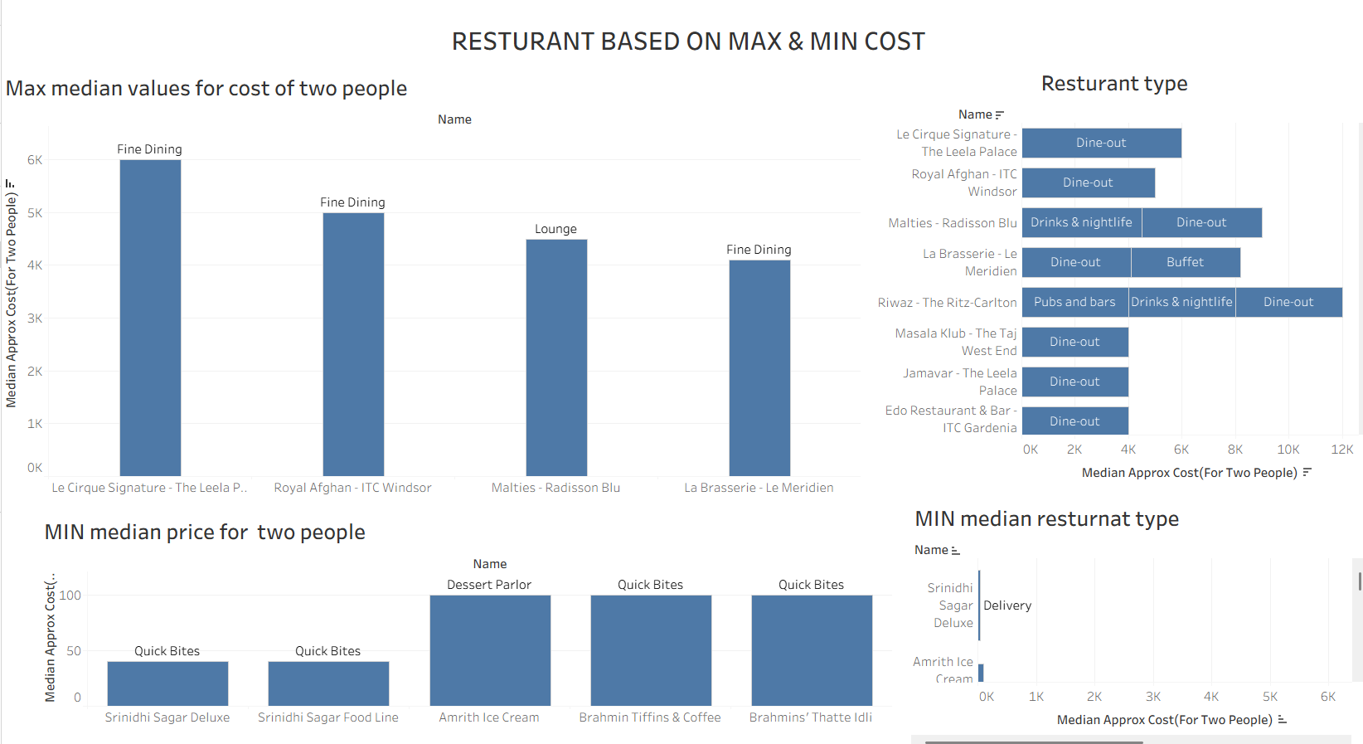
KPI

Slide 5
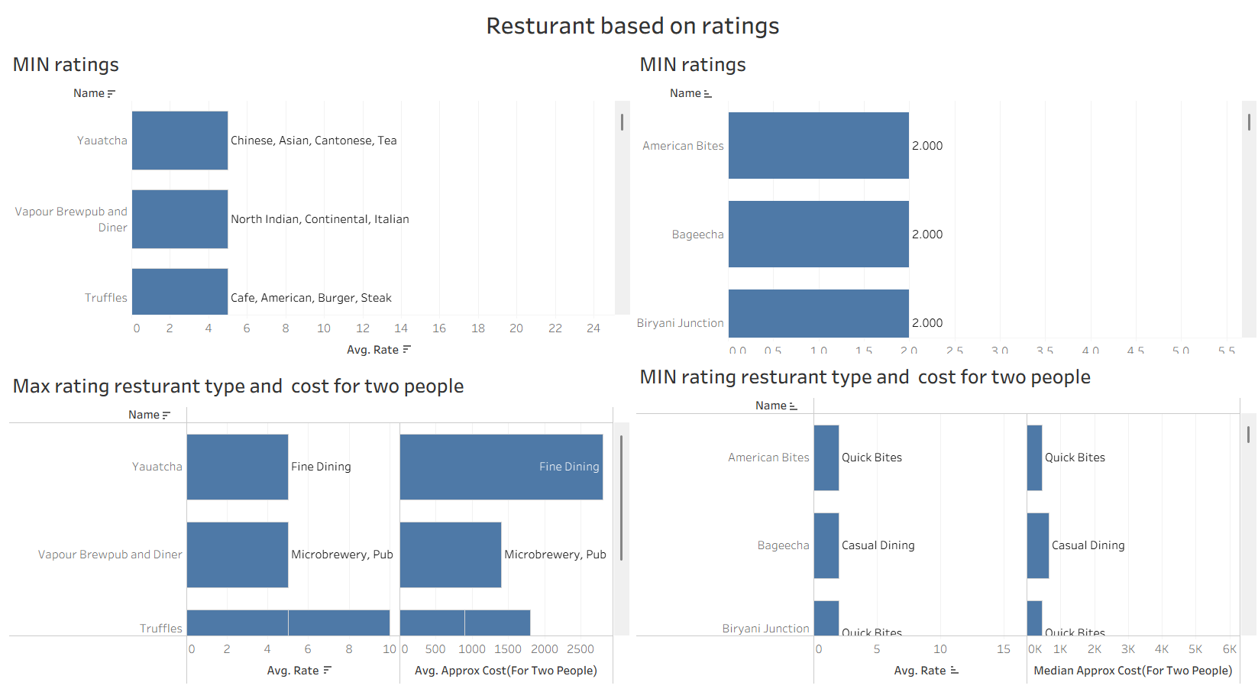
KPI

Slide 6
SUMMARY
Restaurants across every price tier, from budget spots (~₹40 for two) to fine dining (~₹6,000 for two), can achieve high ratings.
Premium pricing and upscale ambiance provide only a marginal advantage; consistent food quality and the right service format (Fine Dining, Quick Bites, Cafe, etc.) are what actually convert customers into satisfied, repeat diners.

Slide 7
CONCLUSION
Success in the F&B market depends more on consistent quality and the right service model than on pricing strategy alone.

Slide 8
RECOMMENDATION
New market entrants and existing restaurants should focus investment on food quality and operational consistency, adopt competitive mid-tier pricing, and align their service format to customer expectations. Deeper, localized consumer surveys are recommended to further refine pricing and format decisions by region and cuisine.

Slide 9
Thank you

